Slide 1
Contents
What is Docker and why we need it?
Installation and configuration
Running the first docker container
Deploying Jenkins as a docker container.
Most commonly used docker commands
Difference between Image and Container
Docker’s Architecture

Slide 2
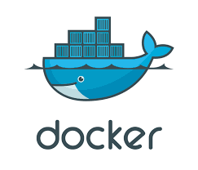
What is Docker?

Slide 3
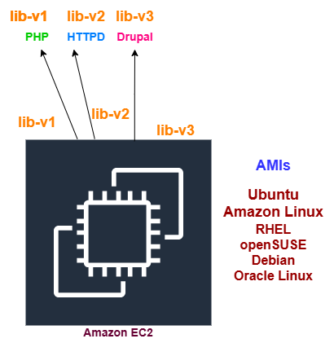
Deploying an App without Docker

Slide 4
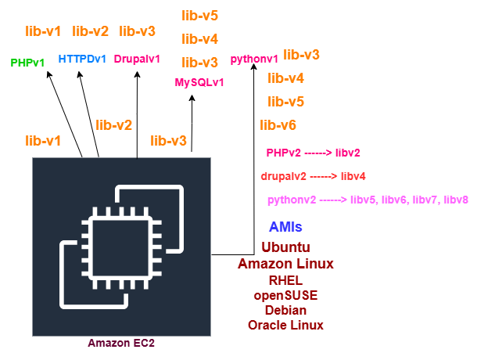
Deploying an App without Docker (2nd Scenario)

Slide 5
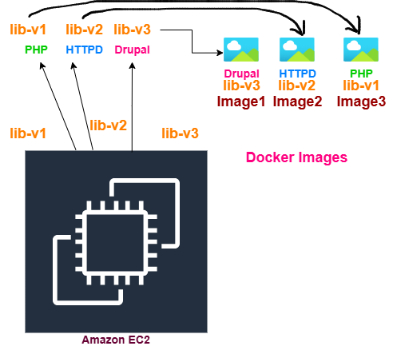
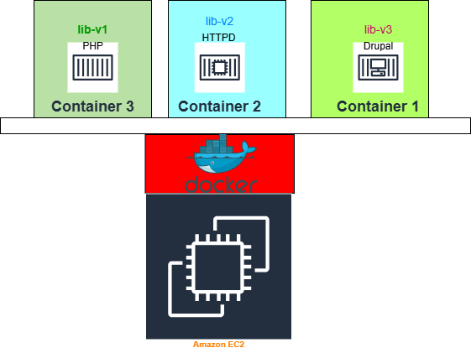
Deploying an App with Docker
Image3
Image2
Image1

Slide 6
Install and Configure Docker
Install docker on Ubuntu: https://docs.docker.com/engine/install/ubuntu/
sudo systemctl status docker
docker ps
docker ps -a
sudo usermod -aG docker ubuntu
docker run -d -p 8080:8080 --restart=on-failure jenkins/jenkins:lts-jdk17
docker exec 54724b1adf85 cat /var/jenkins_home/secrets/initialAdminPassword

Slide 7
Most common docker commands 1
# Create and start a new container from an image
docker run
# Start, Restart or Stop one or more stopped containers
docker start / docker stop / docker restart
# Remove one or more containers
docker rm
# Run a command in a running container
docker exec
# Fetch the logs of a container.
docker logs
# List running/all containers
docker ps / docker ps –a
# Build an image from a Dockerfile
docker build

Slide 8
Most common docker commands 2
# Pull an image or a repository from a registry
docker pull
# Push an image or a repository to a registry
docker push
# List images
docker images
# Remove one or more images
docker rmi
# Create a tag TARGET_IMAGE that refers to SOURCE_IMAGE.
docker tag SOURCE_IMAGE[:TAG] TARGET_IMAGE[:TAG]
# Display a live stream of container(s) resource usage statistics
docker stats
# Show docker disk usage
docker system df

Slide 9
Most common docker commands 3
# Show the history of an image
docker history [OPTIONS] IMAGE
# Return low-level information on Docker objects
docker inspect
# List volumes
docker volume ls
# Create a new volume
docker volume create
# Display detailed information on one or more volumes.
docker volume inspect
# Remove one or more volumes
docker volume rm
# Remove all unused containers, networks, images
docker system prune

Slide 10
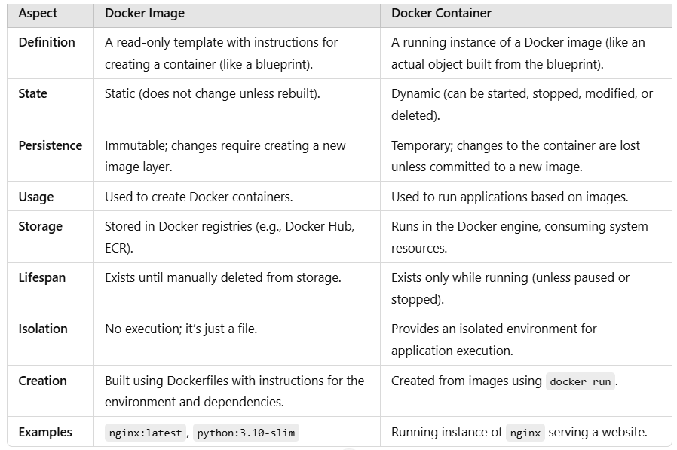
Docker Image Vs Docker Container

Slide 11
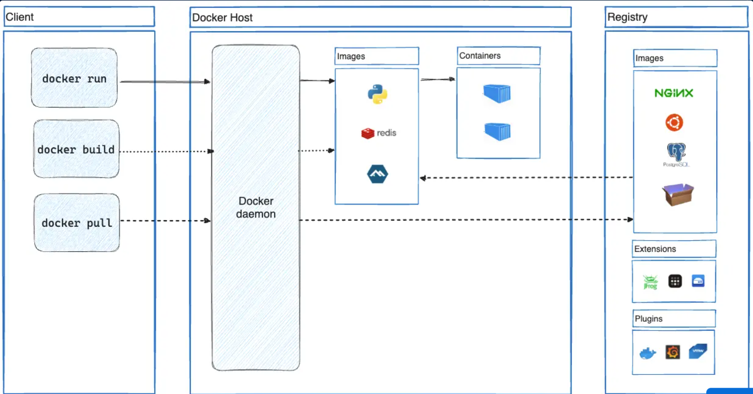
Docker’s Architecture

